Slide 1


Definitely Not Mario
Juan Rios
Denis Rugira
Andrew Johnson
JP Habimana

Slide 2
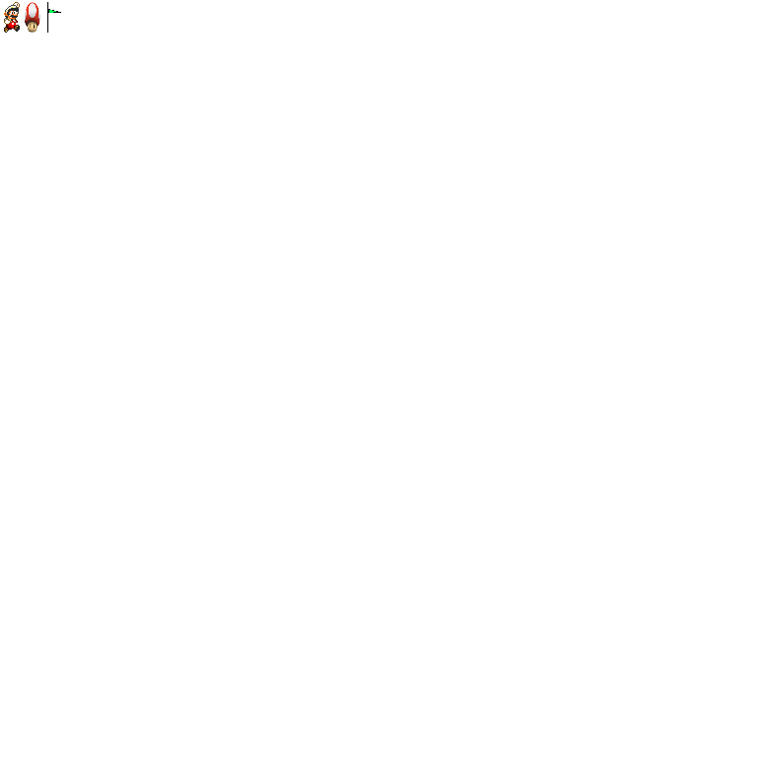
User Stories
As a player, I want a limited number of lives and to decrease that number when I hit an enemy
As a player, I want there to be multiple enemies to dodge
As a user, I want the level to go for more than a single screen and for it to scroll whenever I move far enough to the right.

Slide 3
User Stories
As a user, I want to be presented with a new screen whenever I complete the level.
As a user, I want to be presented with a Game Over screen whenever I run out of lives.
As a user, I want my score to be determined by how quickly I complete the level.
Also, we had a couple of bug fixes dealing with jumping

Slide 4
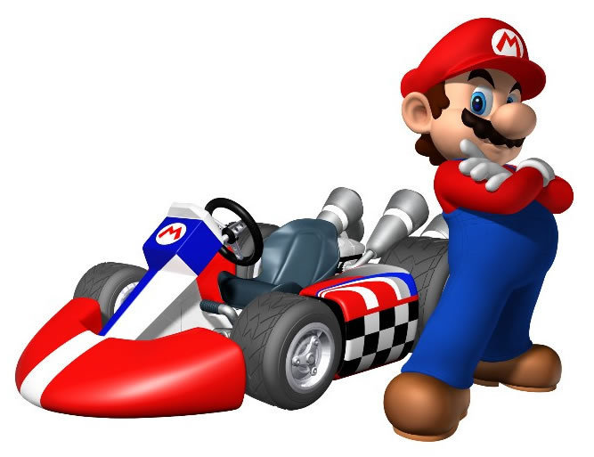
Test-Driven Development
In short, much more difficult to do this release ☹
Why? Engine calls!
The JGame engine deals with collisions, which is what much of our code utilizes
We did test the overriding of old scores
This was code of our own design

Slide 5
Test Method
@Test
public void Delete_test() throws IOException
{
boolean exist = false;
//adds a user as if new to the system
test.addNewUser("Sixbert",10);
boolean expected = true;
//Read_file will return true if user exists
exist = test.Read_File("Sixbert");
//We want to assert that it does indeed exist
assertEquals(expected,exist);
//DeleteOldScore will go through the file and delete
//the previous score so we can write a new one without
//making a copy of the same user
test.DeleteOldScore("Sixbert");
exist = test.Read_File("Sixbert");
assertEquals(false,exist);
}

Slide 6
DEMO

Slide 7
Post-Mortem
Successfully have a single level of a game extremely dissimilar to Mario
Learned how useful Test-Driven Development can be
Also how careful you have to be designing tests!
Also learned the utility of Pair Programming
Also learned how difficult it can be to get schedules to line up
Learned a teensy bit of version control
Overall success: Not being sued by Nintendo!

Slide 8
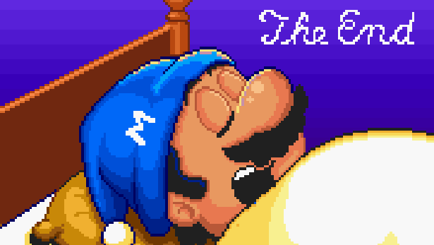
Questions?

